Slide 1
OSCAT
Open Source Community for Automation
Technology
Overview
Nov 2010

Slide 2
What is OSCAT
Library for IEC61131-3
Hardware independent
Open Source
License free
Growing development community

Slide 3
OSCAT Mission
OSCAT Creates open source libraries for IEC61131-3 for all basic needs.
OSCAT focuses on portability and standardization among the great variety of PLC hardware platforms.
OSCAT shares its IP among all PLC programmers and greatly benefits from the experience and input of it's users.

Slide 4
Available Libraries
 | Codesys 2.3 | Codesys 3.0 | Step 7 | PCWorx
OSCAT BASIC | 3.32 | 3.32 | 3.32 | 3.32
OSCAT Network | 1.1 | 1.1 |  | 1.1
OSCAT Building | 1.0 | 1.0 |  | 1.0
OSCAT File System | Q2/2012 | Q2/2012 | Q2/2012 | Q2/2012

Slide 5
Open Source Library
Easy transfer between different systems
100% open source code
Tested on multiple Hardware platforms
Tested in various applications
Highly optimized code for best performance
Continuous maintenance
frequent releases and updates
detailed revision and release history
revision tracking on module level

Slide 6
IEC61131-3 Standard ?
100% based on ST for portability
using basic IEC61131 Statements
Using Standard.LIB
No Hardware specific code
Hardware adaptation in one place or setup

Slide 7
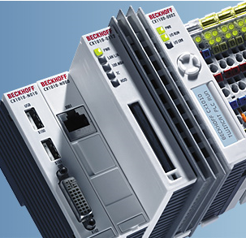
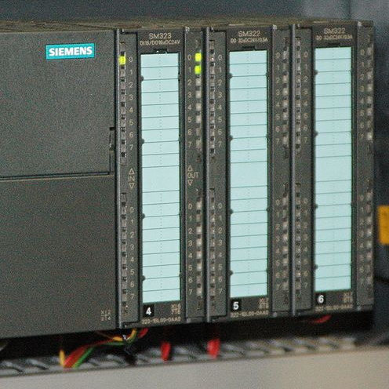
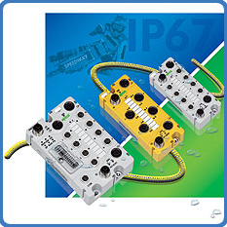
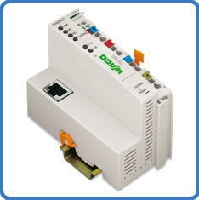
before OSCAT
APP 1
APP 2
APP 3
APP 4
Lib 1
Lib 2
Lib 3
Lib 4

Slide 8
with OSCAT
Independent APPLICATION
OSCAT Library

Slide 9
OSCAT advantages
Independent of Development Tool
  Codesys 2
  Codesys 3
  PCWorx
  Step7
  More to come soon
Independent of Hardware
Open Source for Debugging
Change and create your own

Slide 10
Cross Platform availability
Codesys 2
Codesys 3
Multiprog / PC-Worx
STEP7
Text format for easy import in other systems
Based on IEC61131-3 functions
Hardware tested on multiple Platforms / CPUs
Further Platforms in preparation

Slide 11
OSCAT Platform Usage
Data from OSCAT user Forum December 2008
OSCAT is used on the following platforms
Codesys 2.3 43%
Twincat 19%
Step 7 19%
Codesys 3.0 6%
PCWorx/MProg 6%
Andere 8%

Slide 12
OSCAT Hardware Usage
Data from OSCAT user Forum December 2008
OSCAT is used with the following Hardware
Wago 29%
Beckhoff 22%
Siemens 19%
Moeller 9%
Micro Innovation 6%
Andere 15%

Slide 13
Testing and Verification
Development on different systems assures independence of code
Runtime tests on different hardware systems
Testing with random patterns
Test of math functions to 6 digits resolution
Test program for all functions
Projects verify the library on different systems
Verification under different development systems
OSCAT works together with most other libraries

Slide 14
Most complete Library
The OSCAT Library keeps growing
Continuous improvement of code
Inputs from many users and applications
Open source guarantees flexibility
OSCAT is optimized for 32 bit non FPU CPUs
Extraordinary performance also on 16Bit CPUs

Slide 15
OSCAT components
Over 1000 Library Modules available
Mathematics
Time/Date
String / List / Buffer
Networking
Automation / Control
Networking
..........

Slide 16
License
OSCAT is free of charge
  Private use
  commercial usage
No License agreement necessary
Application Code does not have to be opened

Slide 17
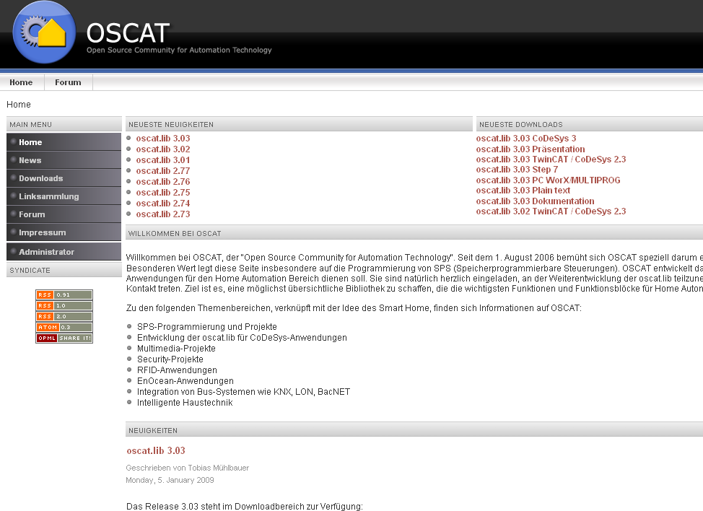
WWW.OSCAT.DE

Slide 18
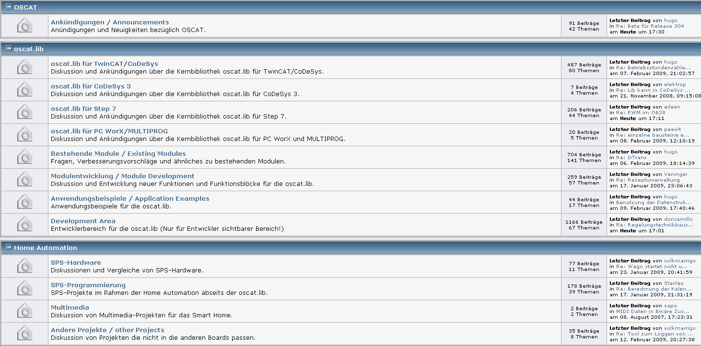
USER FORUM

